Slide 1
2018 Westlake Cross Country

Slide 2
TO DO LIST
Complete your sports physical by July 31st
Complete your Rank One paper work online
Sign and return your team contract
Sign up for Remind – Text service
5. Have fun, relax and run over the summer

Slide 3
Sports Physical
http://www.westlakenation.com/index.php/home/athletic-forms
Link for digital copy of sports physical (on the bottom of the page)
Link for Rankone sport at the top

Slide 4
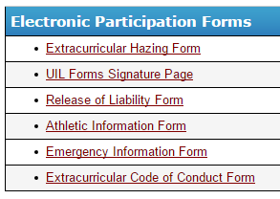
PAPER WORK
July 31st – First Day of Practice @ WHS
RANK ONE ATHLETICS
https://eanesisd.rankonesport.com

Slide 5
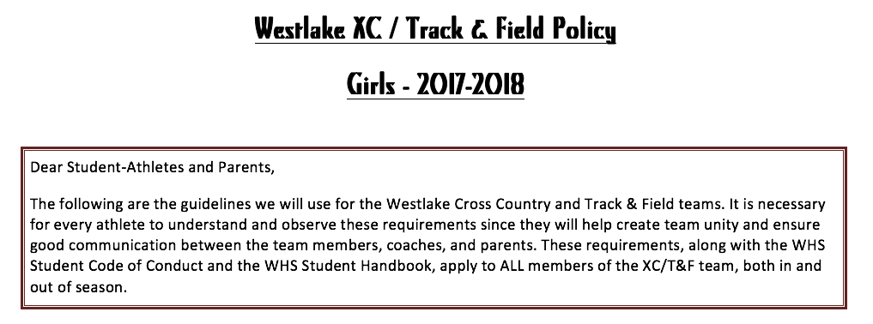
Team Contract
State Expectations for all our athletes
Eligibility - Behavior
Attendance - Grade
Lockers - Etc…

Slide 6
Team Contract
All athletes and their parents must sign and return the contract by the end of the 1st week of practice
Boys Contract: http://whsbbonnecarre.weebly.com

Slide 7
REMIND – TEAM COMMUNICATION
All team communication is sent through the remind app as an email or text. No need for downloading an app….…. please sign up

Slide 8
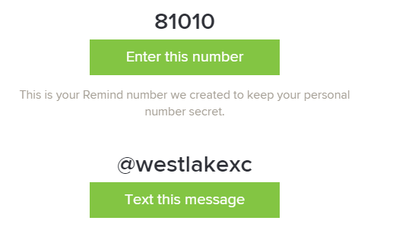
BOYS TEAM

Slide 9
ALL IMPORTANT MEET & PRACTICE INFO
School Webpages
Bonnecarrere – Boys Team
http://whsbbonnecarre.weebly.com

Slide 10
IN SEASON TRAINING
July 31st – First Practice
Westlake High School – Time Trial for boys and girls teams
Establishing a baseline for our runners
Practice Schedule is on our webpage for dates & locations. All practices start at 7:00am.

Slide 11
DRIVING & PARKING
Yippeee!!!
Trimester rotation
Travel from Zilker Park
Students carpool back to school
Bus will be available at Zilker each morning to drive kids back to school

Slide 12
Meet Schedule 2018 Tenative
July 31st – First Day of Practice - WHS – 7:00 am – 2 mile time trial
August 10th – Practice at Old Settlers Park August 17th – Tri-Meet – Brushy Creek Park August 24th – Vista Ridge Invitational - NonTop 14
August 24th (F) – Friday Night Lights – Top 14 - Woodlands
August 31st (F) – Chap Invitational – SE Metropolitan Park - Del Valle – All Athletes
September 7th Midway Invitational top 14 September 8th – St. Andrews - All Athletes September 15th – Cedar Park - – All Athletes September 23rd – Islander Splash – Regional Course - Top 14
September 30th – McNeil – Old Settlers Park – All Athletes October 9th – District Meet - Old Settlers Park – All Athletes
October 23rd (Mon) – Region IV XC Meet – TOP 7 November 3rd – State - Qualifiers November 17th – Nike Cross Regionals - Woodlands

Slide 13
Team Fee
$40
Snacks after Meets & Travel
Travel expenses
Banquet for athletes
Please make check payable to Chap Club
Memo line – Boys or Girls XC

Slide 14
Chap Invitational
GOALS:
Put on a great meet for the kids – Night Race
Only Home Meet & Fundraiser
Expectation that all families help at the meet
Set-up
Work a shift during the meet
Clean up

Slide 15
We're using VolunteerSpot to organize our upcoming CHAP INVITATIONAL Sign-ups.
Here's how it works in 3 easy steps:
Click this link to see our Sign-Up on VolunteerSpot: http://vols.pt/qTvq3B
2) Review the options listed and choose the spot(s) you like.
3) Sign up! It's Easy - you will NOT need to register an account or keep a password on VolunteerSpot.
Note: VolunteerSpot does not share your email address with anyone. If you prefer not to use your email address, please contact me and I can sign you up manually.

Slide 16
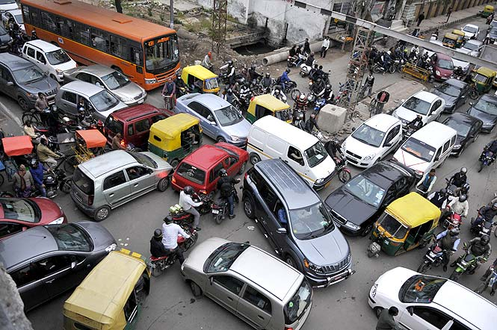
Traffic – Chap Invitational

Slide 17
ACL Music Festival National Holiday in Texas
October 5-7………..October 12-14
District October 9th – Please stay away from the 1st weekend
FR/JV – 2nd weekend – Have fun
Varsity – 2nd weekend – Pick 1 day at most

Slide 18
Running Gear / Uniform
Shorts
Appropriate Top
Quality pair of running shoes
Spikes vs Flats
School Gear
Issued
Ordered – sweatshirt & shirt

Slide 19
Team Parent – Moms or Dads
Help needed please?

Slide 20
QUESTIONS?

