Slide 1
The United State’s Entrance to World War I
Lauren Rizzi, Annie Shwartz, Erin Hawley
Bonnecarrere, 4th

Slide 2
Prompt
“The United States entered the first World War not ‘to make the world safe for democracy’ as President Wilson claimed, but to safeguard American economic interests.” Assess the validity of this statement.

Slide 3
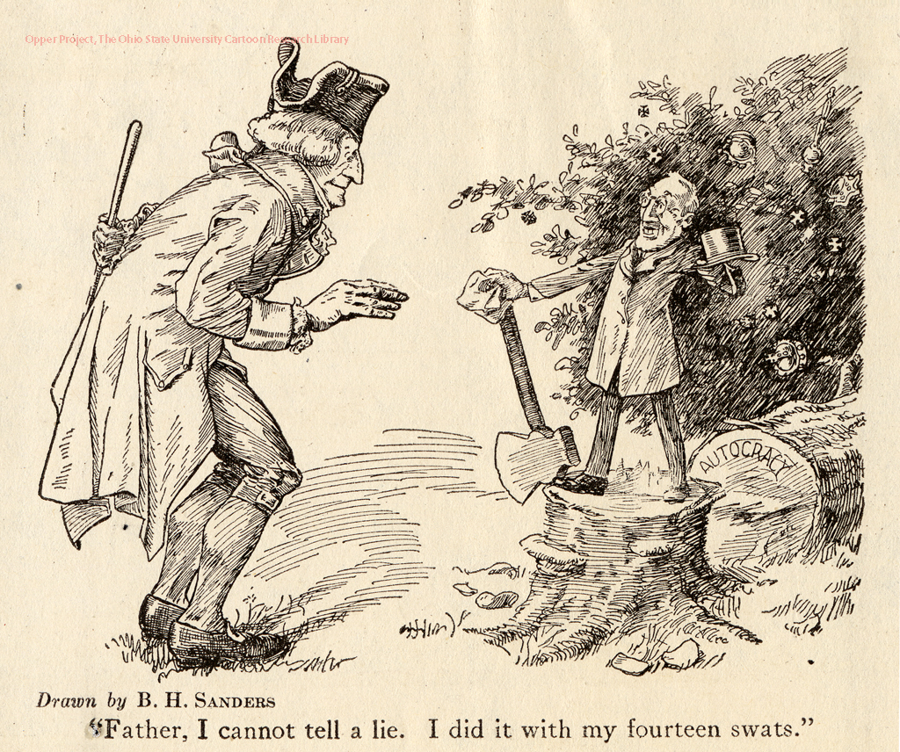

Slide 4
Thesis
Despite his ostensibly altruistic declaration of the defense of free government by the people, President Woodrow Wilson’s chief concern in entering the Great War was the guarantee of America economic interests abroad, as stated outright in his “Fourteen Points” address, evidenced by the nature of the entrance to the war, and demonstrated in past American-foreign interactions.

Slide 5
Wilson’s Fourteen Points Address
Wilson’s attempt at peace after the devastating Great War, his “Fourteen Points” address, earned the president a Nobel Peace Prize. However, much of his efforts were directed at the “removal… of all economic barriers and the establishment of an equality of trade conditions” to secure American economic interests. Peacetime is beneficial to global commerce. This effectively translated to the dismantlement of European alliances that hindered the United State’s ultimate aspiration of global economic hegemony.

Slide 6
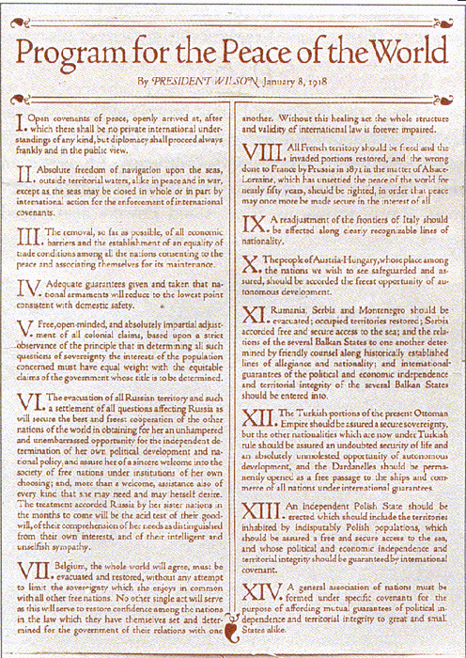
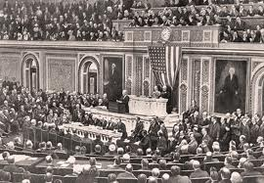

Slide 7
World War I Debts
Industrialization led to global colonization and thus competition amongst world powers. As competition increased, militaries were amassed for defense, and, thus, political alliances were formed. When Archduke Ferdinand was murdered by a Serbian nationalist, a set of reactions of alliances led to the outbreak of World War I. With European nations fighting by obligation, many turned to the United States for financial aid. However, with the prolonged length of the war, the ability of the European nations to pay off the debts began to grow suspect. The United States partially joined the war to regain debts.

Slide 8
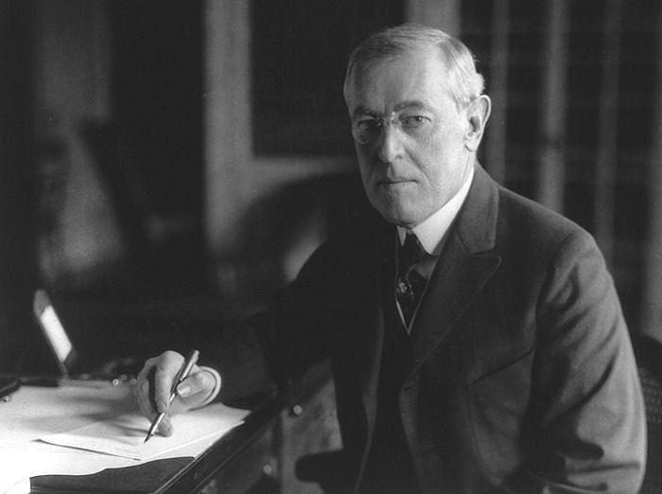

Slide 9
United State’s Past Underhanded Defenses of Democracy
In the past the United States presumably championed the preservation of democracy when in actuality the American government was defending political and economic interests. During the Spanish-American War, the United States touted the defense of democracy as a main reason behind the acquisition of Philippines. Moreover, when President Roosevelt declared his “Big Sister Policy,” or Roosevelt Corollary, his main objective, despite claims of maintaining South American independence, was to keep out European interests

Slide 10
Conclusion
President Wilson’s righteous declaration of protecting democracy for humanity mainly served to justify guarding American investments and interests overseas. His intentions were elucidated in his Fourteen Points address, as well as worries about the debts to America, and previous attempts at global financial manipulation by the United States.

Slide 11
Bibliography
Bailey, Thomas Andrew, David M. Kennedy, and Lizabeth Cohen. The American Pageant. 12th ed. Boston: Houghton Mifflin, 1998. Print.
Rockoff, Hugh. "U.S. Economy in World War I." Economic History Services. Ed. Robert Whaples. Economic Historic Association, 10 Feb. 2008. Web. 19 Feb. 2013. <http://eh.net/encyclopedia/article/rockoff.wwi>.
Wilson, Woodrow. “Fourteen Points.” United States Congress. Washington, D.C. 8 Jan. 1918. Address.

