Slide 1
2019 Westlake Girls Track

Slide 2
TO DO LIST
Complete your sports physical
Complete your Rank One paper work online
Sign and return your team contract
Sign up for Remind – Text service
5. Chap Relays volunteers
6. Girls track sponsors

Slide 3
Sports Physical
http://www.westlakenation.com/index.php/home/athletic-forms
Link for digital copy of sports physical (on the bottom of the page)
Link for Rankone sport at the top

Slide 4
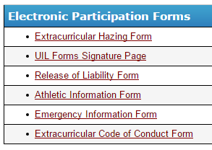
PAPER WORK
July 31st – First Day of Practice @ WHS
RANK ONE ATHLETICS
https://eanesisd.rankonesport.com

Slide 5
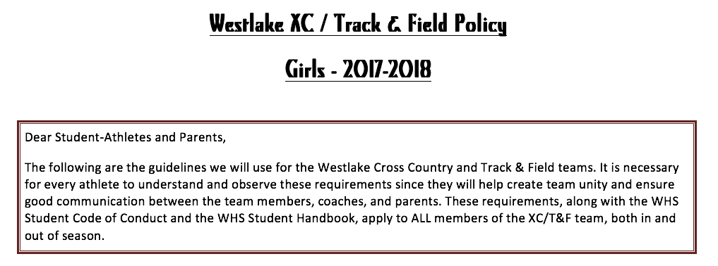
Team Contract
State Expectations for all our athletes
Eligibility - Behavior
Attendance - Grade
Lockers - Etc…

Slide 6
Team Contract
All athletes and their parents must sign and return the contract by the end of the 2nd week of practice

Slide 7
REMIND – TEAM COMMUNICATION
All team communication is sent through the remind app as an email or text. No need for downloading an app….…. please sign up

Slide 8
81010
Then enter @mrbonnec
You will receive all communication sent
It is a one way messaging system

Slide 9
ALL IMPORTANT MEET & PRACTICE INFO
School Webpages
Bonnecarrere – Girls Team
http://whsbbonnecarre.weebly.com
Track
This week in Girls track

Slide 10
IN SEASON TRAINING
Jan 5th – First Practice
Westlake High School
Establishing a baseline for our runners
Practice Schedule is on our webpage for dates & locations.

Slide 11
DRIVING & PARKING
Yippeee!!!
Trimester rotation
Travel from Zilker Park
Students carpool back to school
Bus will be available at Zilker each morning to drive kids back to school

Slide 12
Meet Schedule
2019 Track and Field Schedule
2/7 – Red V. Blue Intra Squad Meet
2/13– JV Meet @ Westlake 2/16 – LT Invitational – Varsity only
2/23 – Chap Relays – Varsity & JV
3/2 – Smithson Valley – Varsity & JV
3/8 – McNeil Invite – Varsity /JV
3/15 & 3/16 – TSU Relays – Varsity only 3/27 – Rouse – JV and those not running at Texas Relays 3/28-30 – Texas Relays – Varsity Only 4/3&4 – District Meet – Varsity – JV – Fr divisions Del Valle HS
4/17-18 – Area Meet – Converse? 4/26-27 – Regional Meet – Alamo Stadium
5/10-11 – State Track Meet

Slide 13
Team Fee
$40
Snacks after Meets & Travel
Travel expenses
Banquet for athletes
Please make check payable to Eanes ISD
Memo line – Girls Track

Slide 14
Running Gear / Uniform
Shorts
Appropriate Top
Quality pair of running shoes
Spikes vs Flats
School Gear
Issued
Ordered – sweatshirt & shirt

Slide 15
Team Parent – Moms or Dads
Help needed please?

Slide 16
QUESTIONS?

