Slide 1
Roosevelt’s and Truman’s Economic Policy: The New and Fair Deals
Maggie Stapler, Lauren Rizzi, Kendall Meyertons, Nishiki Maredia, Erin Hawley
Bonnecarrere, 4th

Slide 2
Prompt
Compare and contrast Truman’s Fair Deal with Roosevelt’s New Deal. In your answer, assess whether the Fair Deal broke any new ground in domestic reforms.

Slide 3
Thesis
Presidents Franklin Delano Roosevelt’s and Harry S. Truman’s respective programs, the New Deal and the Fear Deal, both attempted to better the common man’s life and achieved just that with similar social programs. However, the latter program faced greater opposition as Truman did not enjoy a Democrat majority in Congress as Roosevelt did.

Slide 4
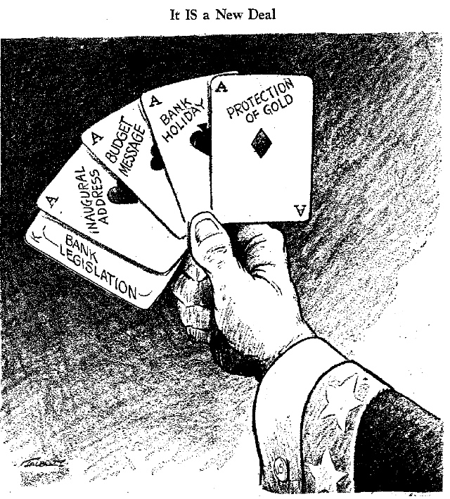

Slide 5
The New Deal
President Franklin Delano Roosevelt entered the White House at a time of financial strife and chaos. To quickly relieve strains, counteract the losses, and prevent future economic recession, Roosevelt established a plan of the “three R’s,” relief, recovery, and reform. The first hundred days in office, the United States experienced a deluge of oversight and accountability organizations and administrations to achieve all three goals.

Slide 6
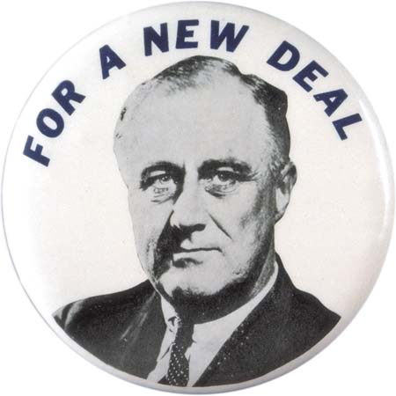
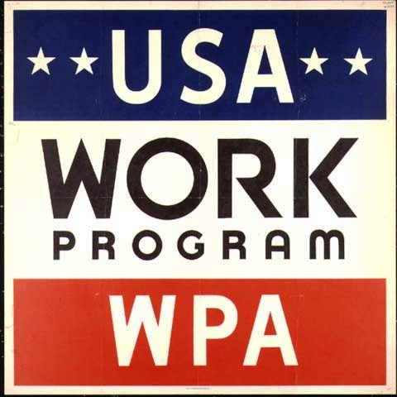

Slide 7
The New Deal
Roosevelt’s philosophy differed greatly from that of his predecessor, President Herbert Hoover, in that Hoover did not believe the federal government’s duty was to serve and aid the American people during hardship. The president’s brain trust advised the commander-in-chief on the best courses of action, while Congress allowed Roosevelt him free reign to efficiently and swiftly carry out improvements. The Emergency Banking Bill of 1933 speedily reformed the banking system, while programs such as the Civil Conservation Corps, which sent three million young men to work in national forests, put people to work.

Slide 8
The Fair Deal
President Truman outlined a sweeping "Fair Deal Program" in his 1949 message to Congress. This financial plan called for improved housing, full employment, a higher minimum wage, better farm price supports, new Tennessee Valley Authority-like programs, and an extension of Social Security. However, most of the Fair Deal fell victim to congressional opposition from Republicans and southern Democrats.

Slide 9
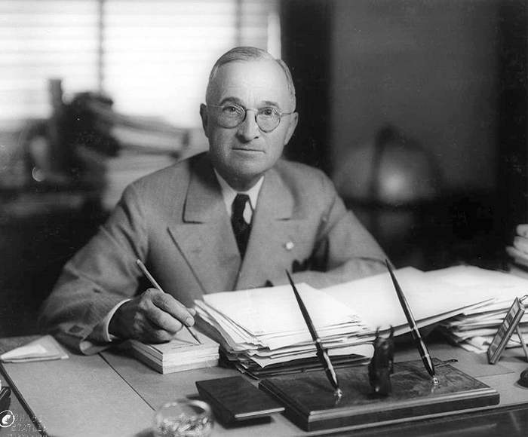

Slide 10
The Fair Deal
The only major success came in raising the minimum wage, providing for public housing in the Housing Act of 1949, and extending old-age insurance to many more beneficiaries in the Social Security Act of 1950.

Slide 11
The Fair Deal and Domestic Reforms
The Fair Deal broke new ground in domestic reforms, but not as much as Truman would have liked. Truman believed that the federal government should guarantee economic opportunity so his ﬁrst priority after World War II was to transition to a peacetime economy. Returning servicemen faced competition for housing and employment. The Servicemen's Readjustment Act of 1944, known as the G.I. Bill, helped ease servicemen back into civilian life by providing such beneﬁts as guaranteed loans for home-buying and ﬁnancial aid for industrial training and university education.
Less than a week after the war ended, he presented Congress with a 21-point program,
which called for protection against unfair employment practices, a higher minimum
wage, greater unemployment compensation, and housing assistance. In the next
several months, he added other proposals for health insurance and atomic energy
legislation. But this scattered approach often left Truman's priorities unclear.
When Truman left ofﬁce in 1953, his Fair Deal was considered a mixed success. In July
1948 he banned racial discrimination in federal government hiring practices and ordered
an end to segregation in the military. The minimum wage had risen, and social security
programs had expanded. A housing program brought some gains but left many needs
unmet. National health insurance and aid-to-education measures never made it through
Congress. Truman's preoccupation with Cold War affairs hampered his effectiveness at
home, particularly in the face of intense opposition.

Slide 12
Similarities Between the New and the Fair Deal
The Fair Deal, President Harry Truman's domestic program, was extremely similar to Roosevelt's New Deal. The Fair Deal just essentially built on the New Deal’s principles and programs. President Truman, like Roosevelt, believed that the federal government should guarantee economic opportunity and social stability. Both Roosevelt and Truman struggled to achieve these goals because of fierce political opposition from conservative legislators who were determined to reduce the role of government, especially by condemning so-called "socialist government programs.”

Slide 13
Differences in FDR’s New Deal
The differences between President Franklin Delano Roosevelt's New Deal and President Harry S. Truman's Fair Deal were that both policies were focused on dealing with the main issues that each respective president encountered in their presidency. Roosevelt was focused on pulling America's economy out of the Great Depression and did so by putting in place many programs that "primed the pump" or jumpstarted the economy. Programs such as the Civilian Conservation Corps, or the CCC, created jobs for young men.

Slide 14
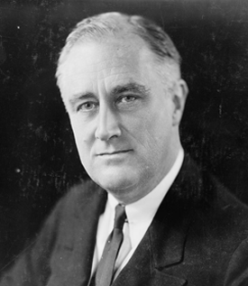
Differences in FDR’s New Deal
Moreover, President Roosevelt's decision to leave the gold standard boosted the failing economy. In addition, Roosevelt created many reform programs such as the Federal Deposit Insurance Corporation, the FDIC, and Social Security Act of 1935.

Slide 15
Differences in Truman’s Fair Deal
During Truman's presidency, the country was still booming in its post-World War Two economy due to the international issues in Korea and Berlin that created a subdued wartime economy. Because the economy was not stressed, Truman took initiative to start dealing with the less severe problems the country was facing. Roosevelt had already created a plethora of jobs in his own presidency, so Truman now attempted to improve those jobs such as raising the minimum wage requirement. Although both presidents were Democrats and tried to provide for the common man, FDR focused on all races of the common man and Truman was focusing on the minorities, hinting at the Civil Rights Movement that was to come.

Slide 16
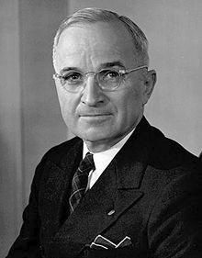
Differences in Truman’s Fair Deal
Lastly, Roosevelt's presidency went smoothly for the most part in Congress due to congress being a Democrat-majority and passed numerous programs in his "First Hundred Days" whereas many of Truman's reforms were shot down in Congress due to the congress shifting to a more conservative-majority.

Slide 17
Conclusion
The New Deal and the Fair Deal, sweeping economic policies of Presidents Franklin Delano Roosevelt and Harry S. Truman, respectively, engendered many positive improvements for the average American. Roosevelt initiated his program in a time of financial chaos, while Truman proceeded in a time of financial prosperity, fixing less severe problems.

Slide 18
Works Cited
Bailey, Thomas Andrew, David M. Kennedy, and Lizabeth Cohen. The American Pageant. 12th ed. Boston: Houghton Mifflin, 2002. Print.
"Harry S. Truman - Domestic Policies." Profiles of US Presidents. N.p., n.d. Web. 06 Apr. 2013.
"The New Deal." American Experience. PBS, n.d. Web. 06 Apr. 2013.

